Slide 1
CSEE 4823 F18 Project Binary-Weight, Binary Activation Neural Network Accelerator based on Latch-based Weight Memory
Dewei Wang, Shixin Qin, Paul Huang
dw2773, sq2210, xh2373

Slide 2
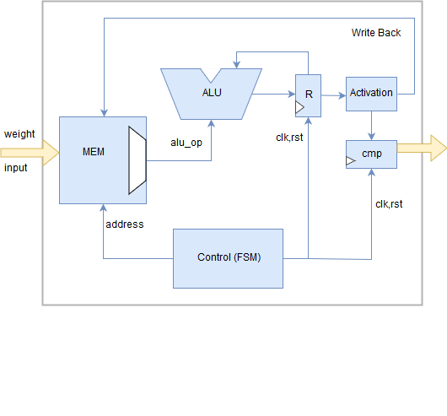
Goal and Architecture
Goal: Accuracy and energy-efficiency
Architecture: +1/-1 weights; +1/-1 activations; 784-1024-1024-1024-10 fully-connected; latch-based weight memory; 1R1W weight memory; FSM control

Slide 3
Characterization Methods and Results
Methods
Input: 20-k test dataset from the MNIST benchmark
RTL coding from a scratch: Yes
Throughput: Tested in RTL simulation
Maximum clock frequency: The minimum clock period in timing.tcl to meet the slack in PT and DC-gen report file.
Area and number of gates: DC-gen report (memory has not been synthesized)
Accuracy: using the 20-k test dataset from the MNIST benchmark
Results
Throughput: 12 [classficiation/s]
Maximum clock frequency: 200 [MHz]
Area and number of gates: 0.004304 [mm²] and 393 gates memory has not been synthesized)
Total memory bits: 4[MB]
Accuracy: 97%

Slide 4
Copy your RTL (not netlist) and the testbench in a single file; double-click below↓
Copy your run.do file; double-click below↓

